Slide 1
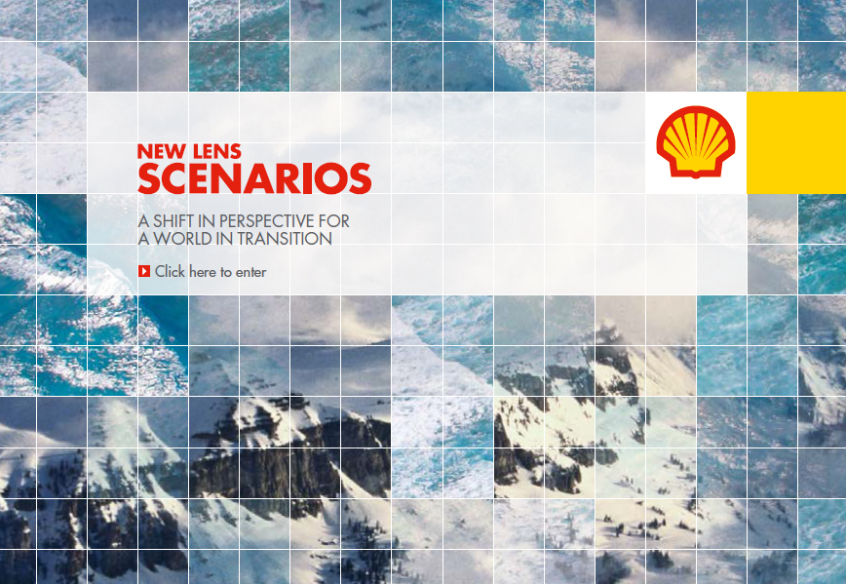
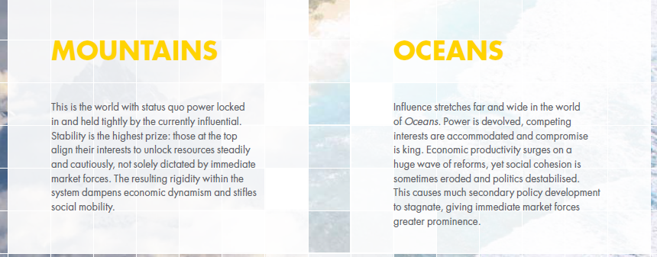
Examples of scenario exercises
Shell New Lens Scenarios – an example of corporate scenario design
Shell developed an early corporate lead in scenario planning
Wack, P. (1985). Scenarios: shooting the rapids. Harvard Business Review.
Wack, P. (1985). Scenarios: uncharted waters ahead. Harvard Business Review, 73–89.

Slide 2
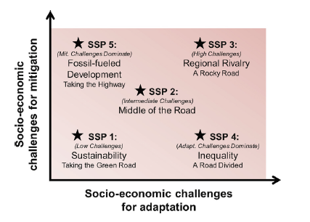
Examples of scenario exercises
Shared Socioeconomic Pathways (SSPs) – widely use by the research community
Set of scenarios developed by the Climate Change research community, describing future climate, societal and environmental change.
Using Integrated Assessment Models to fill these with quantitative insights.
https://www.climatescenarios.org/primer/
Source: O’ Neill B.C. et al, Global Environmental Change, 2015.

Slide 3
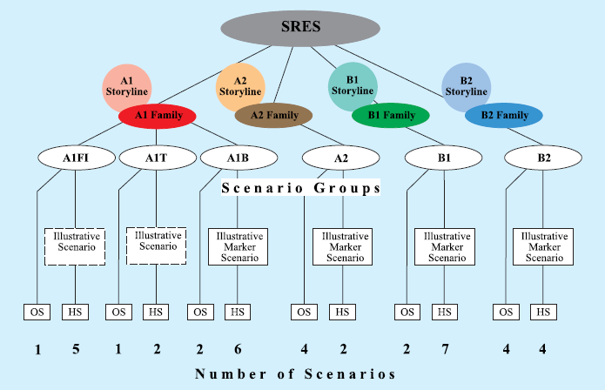
Examples of scenario exercises
IPCC Emission Scenarios
First developed in 1990.
Don’t take into account UNFCCC or Kyoto commitments.
Span large range of uncertainty on GHG emissions.
Source: IPCC Special Report: Emission Scenarios.

Slide 4
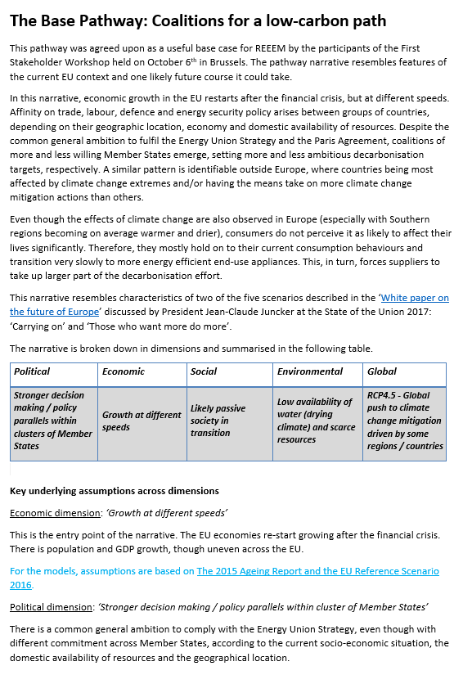
Examples of scenario exercises
H2020 REEEM Pathways
Three scenarios describing EU transition towards a low-carbon economy:
Base Pathway – no major disruptions
Local Solutions Pathway – society taking action
Paris Agreement Pathway – EU for a well below 1.5 C world

